Slide 1
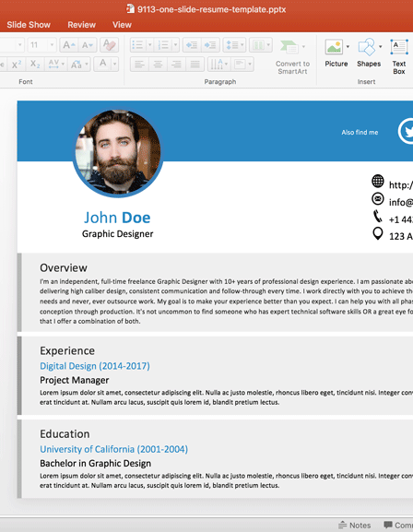
Resume Builder
This Photo by Unknown Author is licensed under CC BY

Slide 2
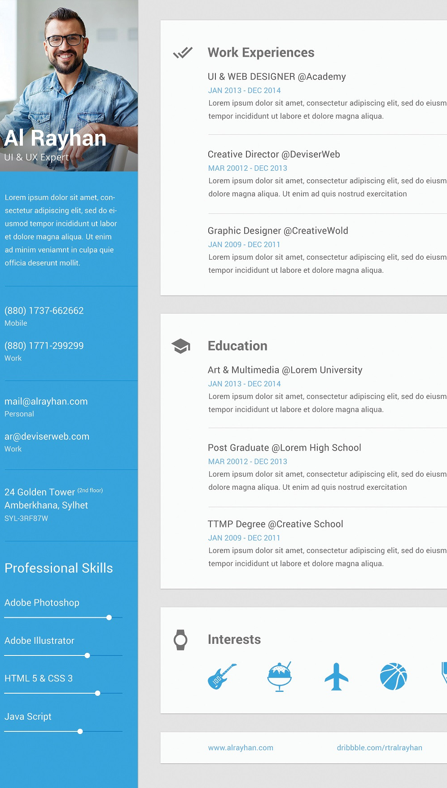
Introduction
Creating a standout resume has never been easier. At Resume Builder, we provide you with the tools and templates to craft a professional resume that highlights your unique skills and experiences. Whether you’re a recent graduate, a seasoned professional, or looking to switch careers, our intuitive platform guides you through every step of the process.
This Photo by Unknown Author is licensed under CC BY-SA

Slide 3
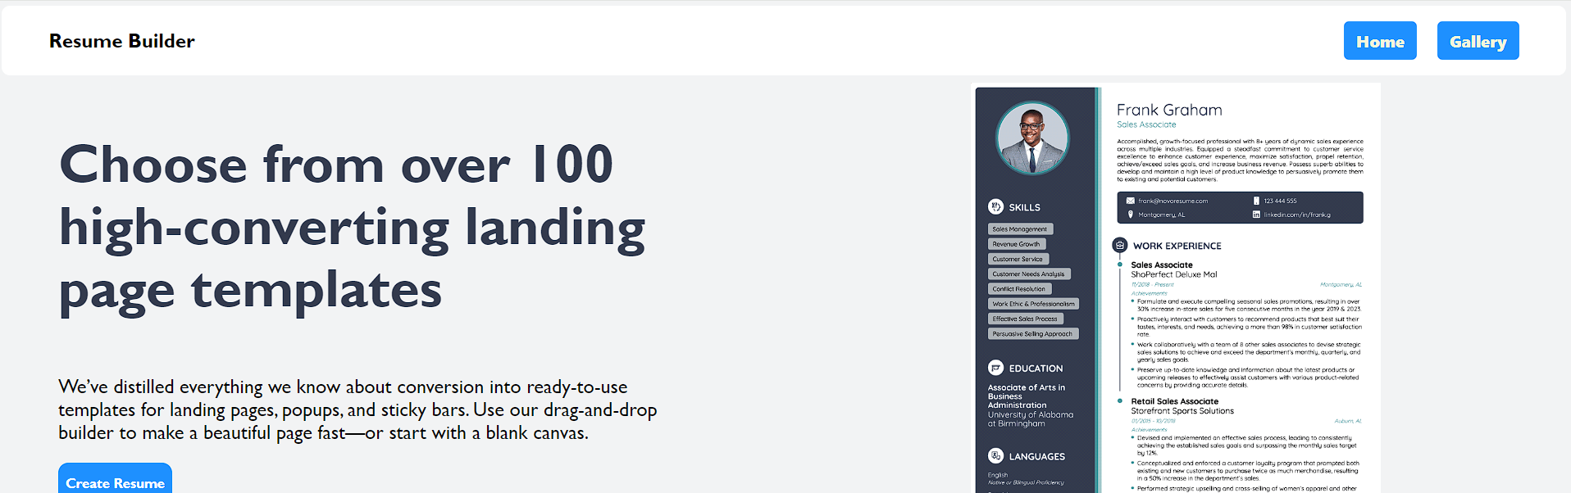

Website image

Slide 4
Website Benifits
User can create an drag their desired elements.
User can freely move elements around the page.
User can change the style colors.
User can change text-color, text-weight, Font-family

Slide 5
Advantage
Time-Saving: Resume builders significantly reduce the time needed to create a resume.
Ease of Use: This resume builders are user-friendly, featuring drag-and-drop functionalities and editable forms.
Professional Templates: They provide access to a variety of professionally designed templates that can make your resume stand out.

Slide 6
Disadvantage
Lack of Customization:This resume builders offer limited customization options.
Template Limitations: This builders restrict you to their fonts and formats, which can be a problem if you want a unique design.
Online Dependency: My builders work purely online, limiting your ability to save or edit your resume offline.

Slide 7
Proportional System
1. User Interface (UI) Design
Clean and Intuitive Layout: Ensure the design is simple and easy to navigate.
Responsive Design: Make sure the page is mobile-friendly and works well on different devices.
2. User Input Handling
Form Fields: Include fields for personal information, education, work experience, skills, and other relevant sections.
3. Template Selection
Multiple Templates: Offer a variety of professional templates that users can choose from.
Customization Options: Allow users to customize fonts, colors, and layout to match their preferences.

Slide 8
Proportional System
4. Real-time Preview
Live Preview: Provide a real-time preview of the resume as the user inputs their information.
Edit Mode: Allow users to switch between edit mode and preview mode easily.

Slide 9
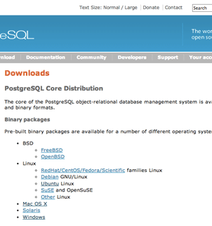
Thank you
Mirjam Nilsson
mirjam@contoso.com
..\Users\balus\OneDrive\Desktop\Project 2024\html\landingpage.html

